Slide 1
BUSCA
Aldo Rogliero
Nyle Malik
John Lee
JingXuan Wang
Salomon Nabine

Slide 2
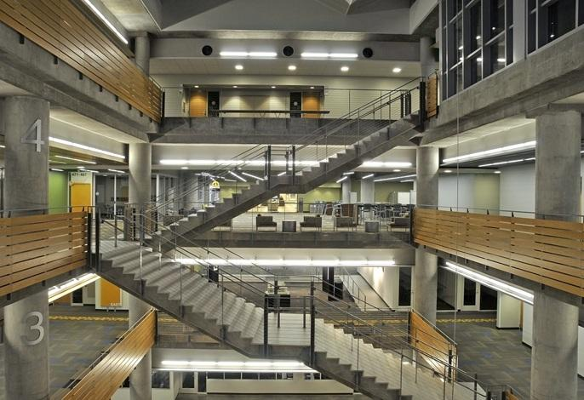
Motivation
The CULC problem
Nice study spaces
Huge building
Always packed

Slide 3
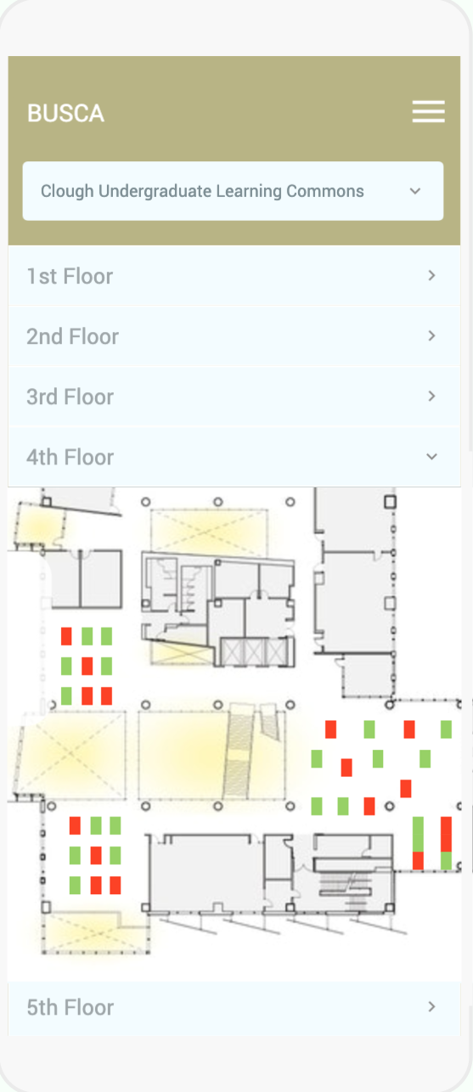
Objective
Connect students with available study spaces in real time
Cost-effective, non-invasive
User friendly UI

Slide 4
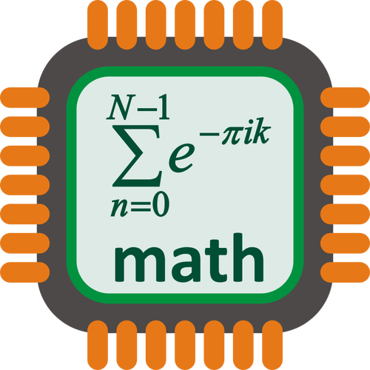
Background
Cloud Server
Microcontroller Unit Network
Proximity Sensor

Slide 5
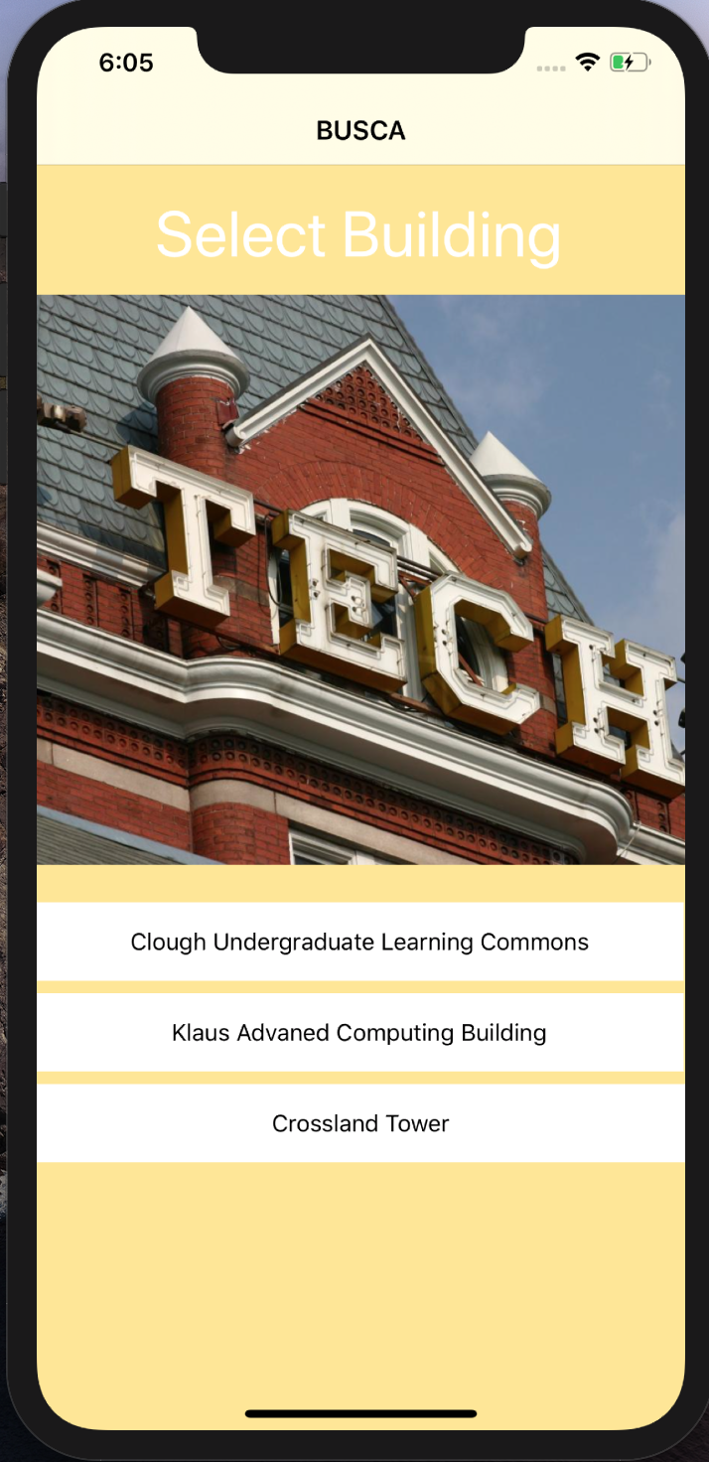
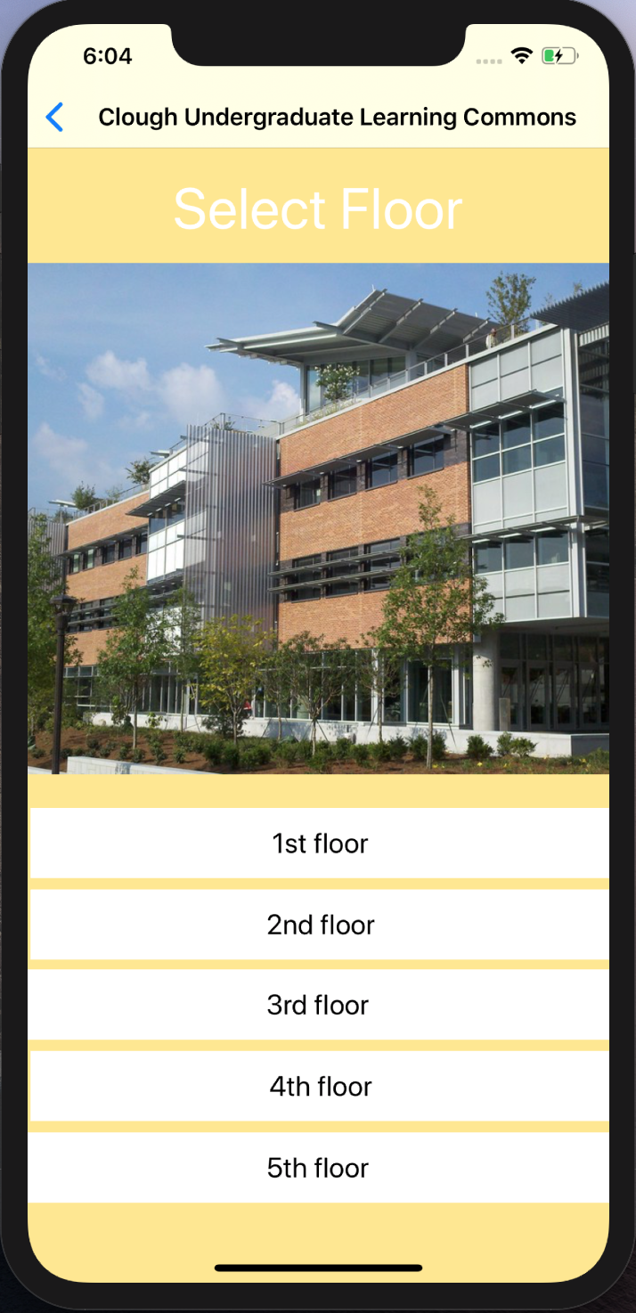
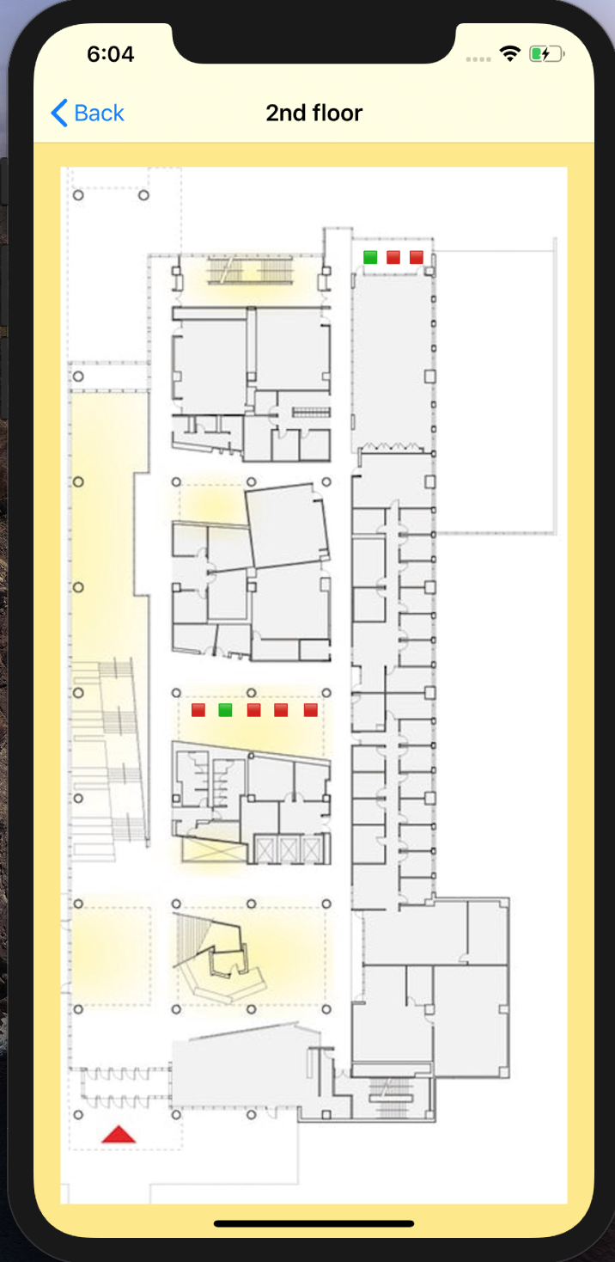
Mobile App-Current Status
UI layout is done
Currently able to successfully retrieve data from the AWS endpoint
Working template class to handle displaying table availability for any floor

Slide 6
Network Architecture-Current Status
Device
End User

Slide 7
Hardware-Current Status
Connected the device via Wi-Fi to AWS IoT
Published dummy messages to AWS IoT
Researched and found demo code for many features
Hibernation timer
Publishing to AWS IoT
I²C Communication
Sensors and mounting hardware has been delivered

Slide 8
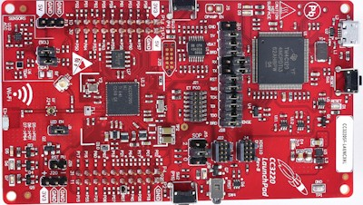
Problems and Challenges
MCU checked out from the senior design lab was broken
Long order delivery time
Bigger learning curve than expected for the app development
Discovery that our sensors need to be mounted to a breakout board

Slide 9
Next Steps
Continue app development
Handle data retrieved from the server properly
Make UI flexible to work on any screen size
Build enough sensor breakouts for development
Format messages sent to AWS IoT to be parseable by Lambda
Create more refined security policies for AWS IoT

